Slide 1
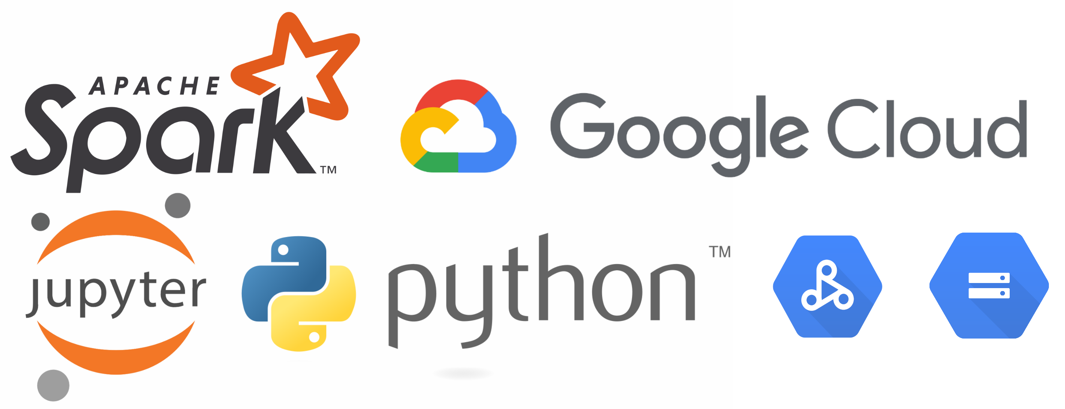
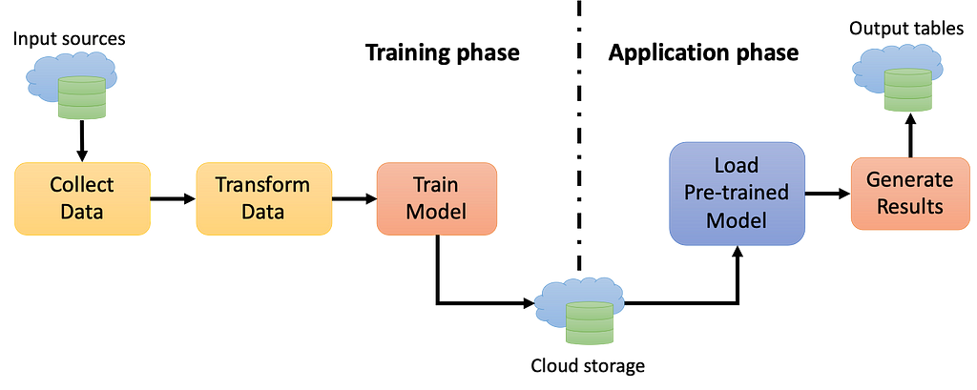
Big Data 3 (Zero To Mastery: ML Models Using PySpark in Cloud Platform)
AI VIETNAM
All-in-One Course
Vinh Dinh Nguyen
PhD in Computer Science
Year 2023
Notes:
https://malware.news/t/saving-and-retrieving-ml-models-using-pyspark-in-cloud-platform/60021

Slide 2

AI VIETNAM
All-in-One Course
The Complex World of Big Data

Slide 3

AI VIETNAM
All-in-One Course
Why use Spark?
Regular machine learning projects are built based on the following step:
Load the data to the disk
Import the data into the machine’s memory
Process/analyze the data
Build the machine learning model
Store the prediction back to disk
Pandas and scikit-learn are fantastic to explore dataset up to mid-size.
The problem arises if the data scientist wants to process data that’s too big for one computer.

Slide 4
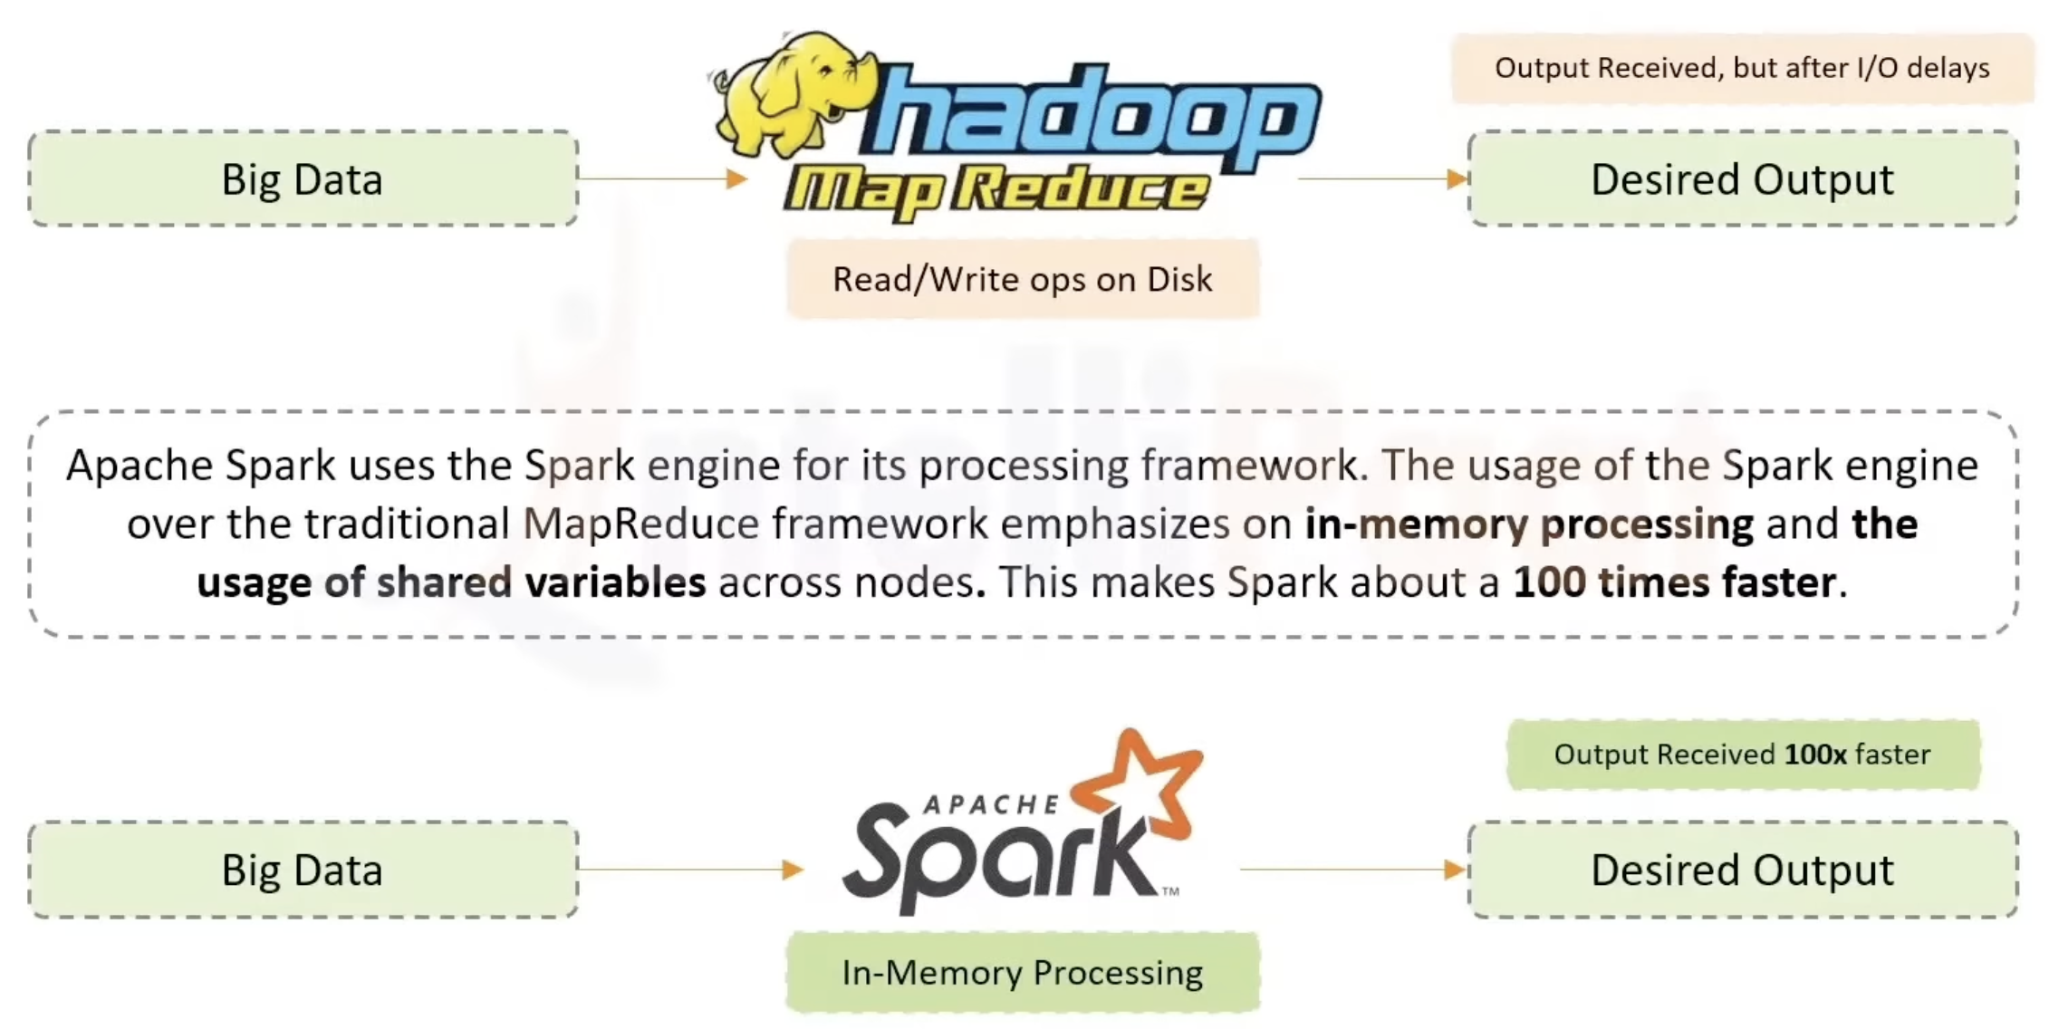
AI VIETNAM
All-in-One Course
What is the Solution?
https://www.youtube.com/watch?v=ANotA_YZjvI&t=21430s

Slide 5
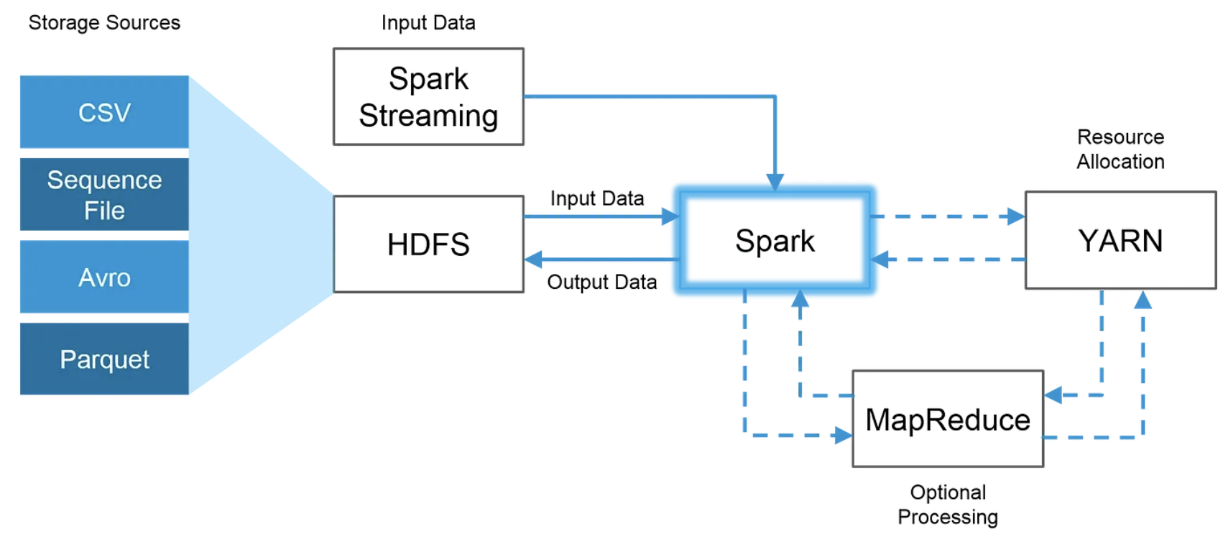
AI VIETNAM
All-in-One Course
How Spark and Hadoop can work together
Notes:
The image above demonstrates how Spark uses the best parts of Hadoop through HDFS for reading and storing data, MapReduce for optional processing and YARN for resource allocation.

Slide 6
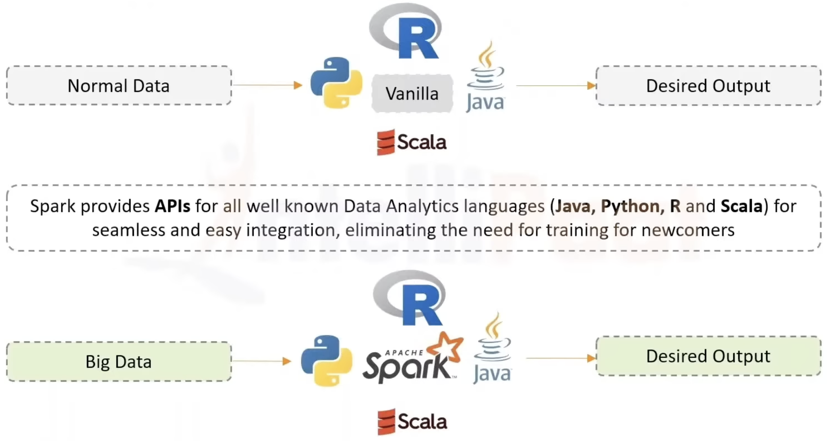
AI VIETNAM
All-in-One Course
How Spark and Hadoop can work together
https://www.youtube.com/watch?v=ANotA_YZjvI&t=21430s

Slide 7
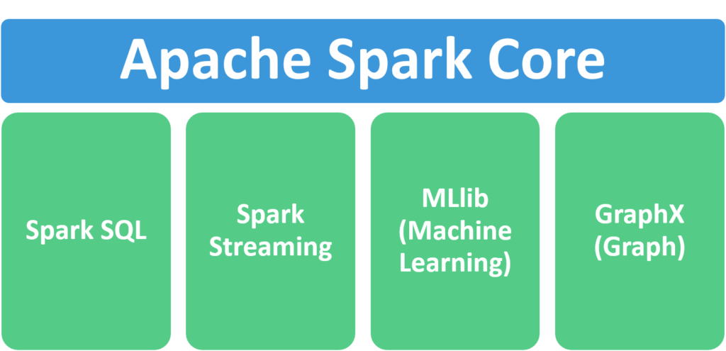
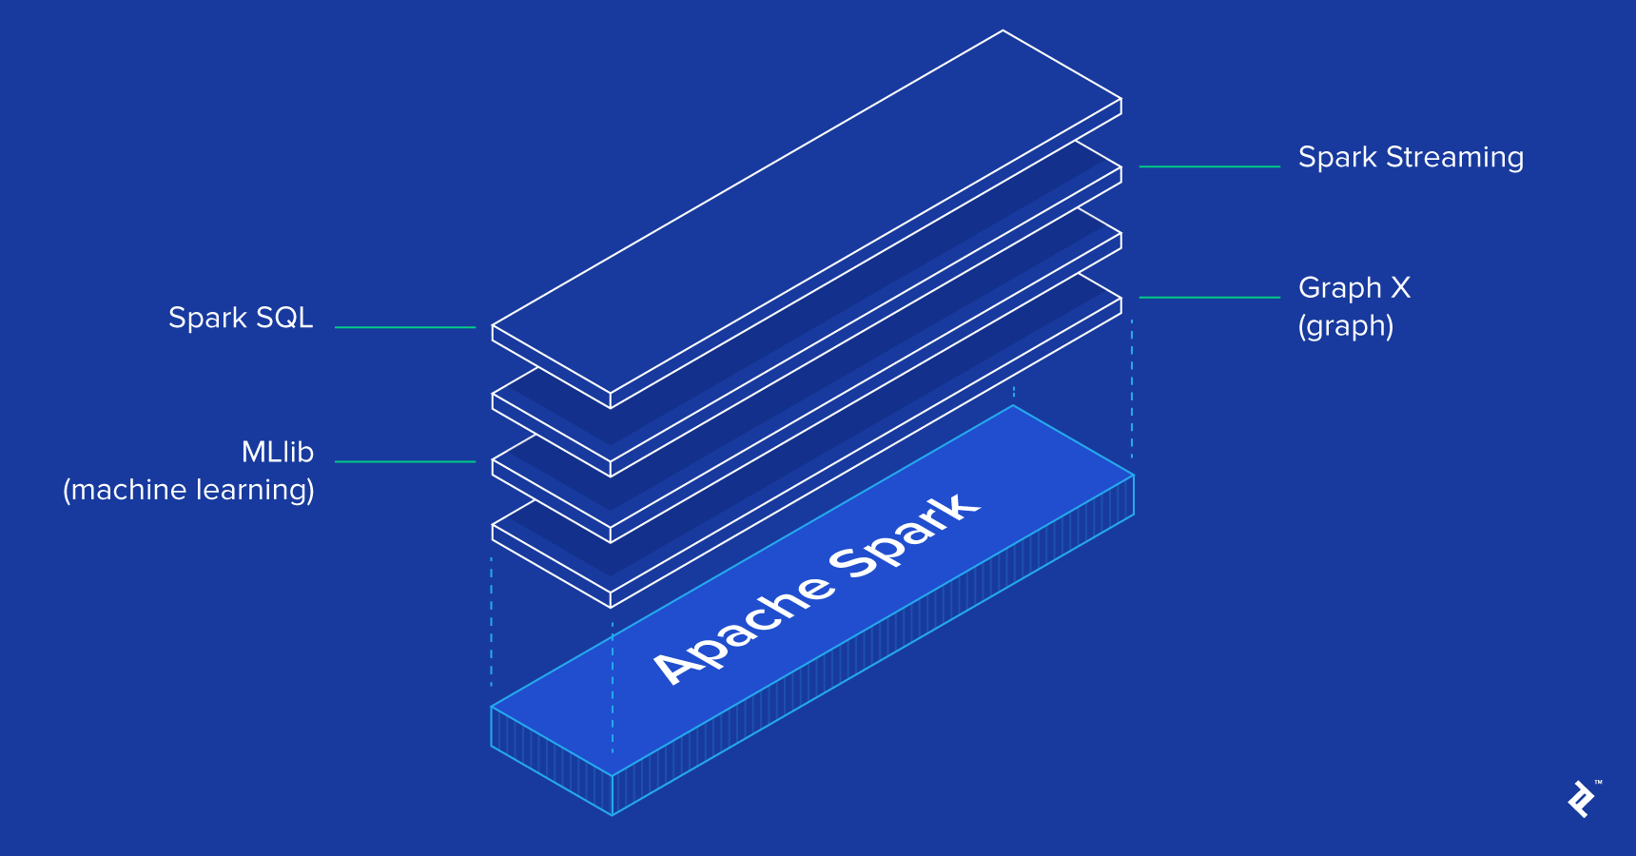
AI VIETNAM
All-in-One Course
How Spark and Hadoop can work together
Notes:
https://chartio.com/learn/data-analytics/what-is-spark/#:~:text=Apache%20Spark%20is%20an%20open,against%20data%20of%20any%20size.

Slide 8
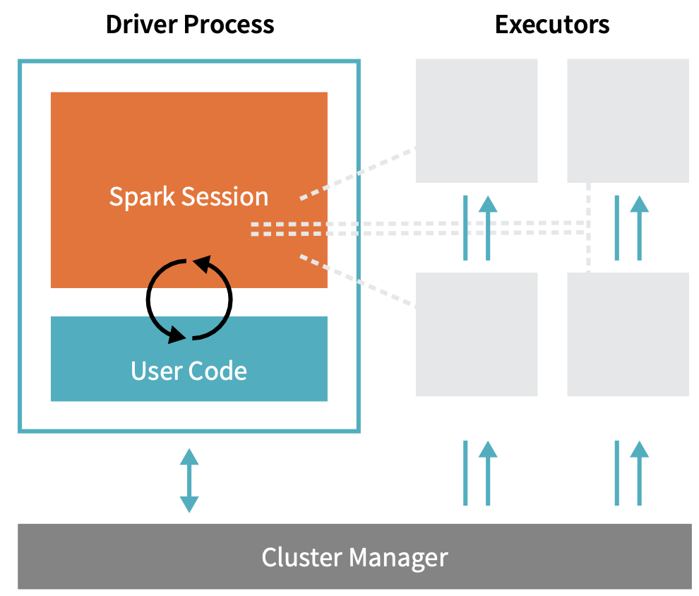
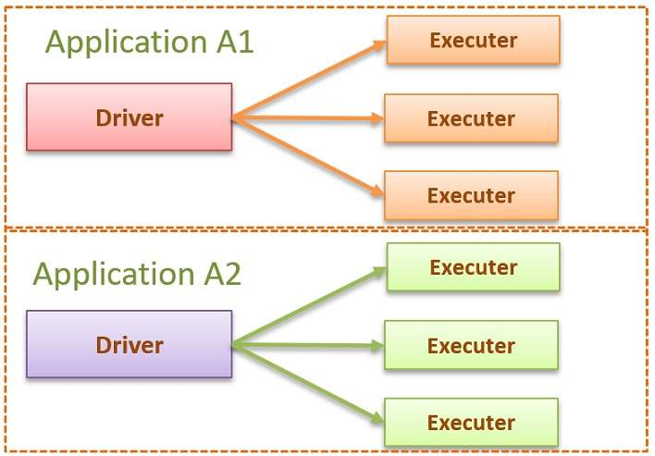
AI VIETNAM
All-in-One Course
Spark Execution Model
https://www.learningjournal.guru/article/apache-spark/apache-spark-internals/
Notes:
Spark is a distributed processing engine, and it follows the master-slave architecture. So, for every application, Spark will create one master process and multiple slave processes. In Spark terminology, the master is the driver, and the slaves are the executors. Let's try to understand it with a simple example.
https://www.learningjournal.guru/article/apache-spark/apache-spark-internals/
The cluster manager controls physical machines and allocates resources to Spark Applications. This can be one of several core cluster managers: Spark’s standalone cluster manager, YARN, or Mesos. This means that there can be multiple Spark Applications running on a cluster at the same time. We will talk more in depth about cluster managers in Part IV: Production Applications of this book.

Slide 9
AI VIETNAM
All-in-One Course
Spark Execution Model
Client Mode - Start the driver on your local machine
Cluster Mode - Start the driver on the cluster
Local Mode - Start everything in a single local JVM.
https://www.learningjournal.guru/article/apache-spark/apache-spark-internals/
Notes:
Spark is a distributed processing engine, and it follows the master-slave architecture. So, for every application, Spark will create one master process and multiple slave processes. In Spark terminology, the master is the driver, and the slaves are the executors. Let's try to understand it with a simple example.
https://www.learningjournal.guru/article/apache-spark/apache-spark-internals/

Slide 10
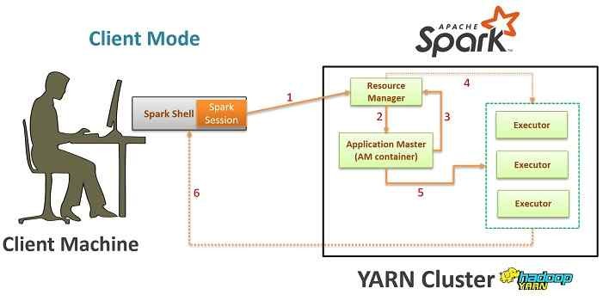
AI VIETNAM
All-in-One Course
Spark on YARN: Client Mode
Notes:
Let's take YARN as an example to understand the resource allocation process. A Spark application begins by creating a Spark Session. That's the first thing in any Spark 2.x application. If you are building an application, you will be establishing a Spark Session. If you are using a Spark client tool, for example, scala-shell, it automatically create a Spark Session for you. You can think of Spark Session as a data structure where the driver maintains all the information including the executor location and their status. Now, assume you are starting an application in client mode, or you are starting a spark-shell (refer the digram below). In this case, your driver starts on the local machine and then as soon as the driver create a Spark Session, a request (1) goes to YARN resource manager to create a YARN application. The YARN resource manager starts (2) an Application Master. For the client mode, the AM acts as an Executor Launcher. So, the YARN application master will reach out (3) to YARN resource manager and request for further containers. The resource manager will allocate (4) new containers, and the Application Master starts (5) an executor in each container. After the initial setup, these executors directly communicate (6) with the driver.

Slide 11
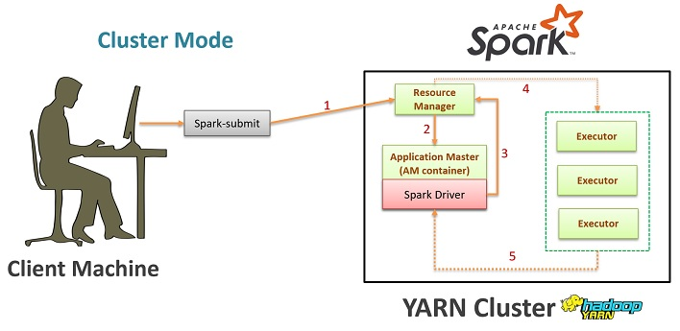
AI VIETNAM
All-in-One Course
Spark on YARN: Cluster Mode
Notes:
The process for cluster mode application is slightly different (refer the digram below). In the cluster mode, you submit your packaged application using the spark-submit tool. The spark-submit utility will send (1) a YARN application request to the YARN resource manager. The YARN resource manager starts (2) an application master. And then, the driver starts in the AM container. That's where the client mode and cluster mode differs. In the client mode, the YARN AM acts as an executor launcher, and the driver resides on your local machine, but in the cluster mode, the YARN AM starts the driver, and you don't have any dependency on your local computer. Once started, the driver will reach out(3) to resource manager with a request for more Containers. Rest of the process is same. The resource manager will allocate (4) new Containers, and the driver starts (5) an executor in each Container.

Slide 12
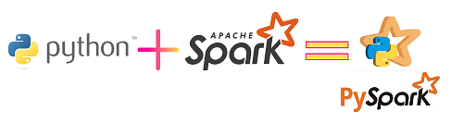
AI VIETNAM
All-in-One Course
Spark’s version of Python: PySpark
Notes:
https://medium.com/mlearning-ai/big-data-fundamentals-with-pyspark-939112ef2281

Slide 13

AI VIETNAM
All-in-One Course
PySpark Architecture
Apache Spark works in a master-slave architecture where the master is called “Driver” and slaves are called “Workers”. When you run a Spark application, Spark Driver creates a context that is an entry point to your application, and all operations (transformations and actions) are executed on worker nodes, and the resources are managed by Cluster Manager.
Notes:
https://sparkbyexamples.com/pyspark-tutorial/

Slide 14
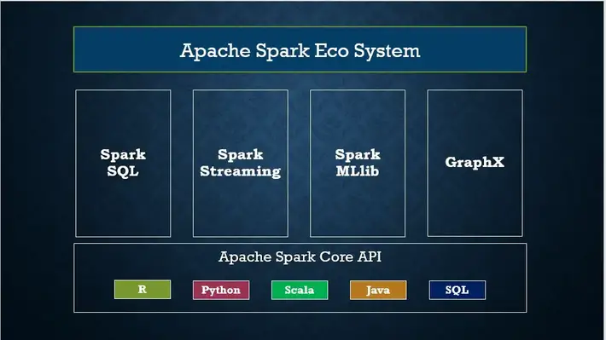
AI VIETNAM
All-in-One Course
PySpark Modules & Packages
PySpark RDD (pyspark.RDD)
PySpark DataFrame and SQL (pyspark.sql)
PySpark Streaming (pyspark.streaming)
PySpark MLib (pyspark.ml, pyspark.mllib)
PySpark GraphFrames (GraphFrames)
PySpark Resource (pyspark.resource) It’s new in PySpark 3.0
Notes:
https://sparkbyexamples.com/pyspark-tutorial/

Slide 15
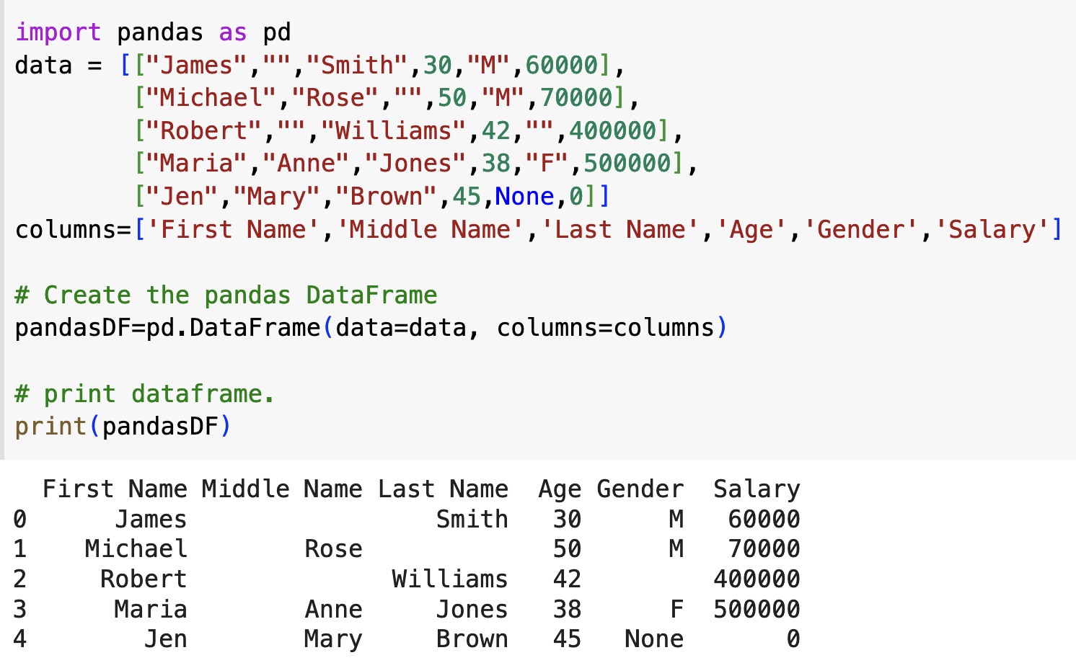
Pandas vs PySpark DataFrame
AI VIETNAM
All-in-One Course
Pandas is one of the most used open-source Python libraries to work with Structured tabular data for analysis. Pandas library is heavily used for Data Analytics, Machine learning, data science projects, and many more.
Notes:
https://sparkbyexamples.com/pyspark/pandas-vs-pyspark-dataframe-with-examples/?expand_article=1

Slide 16
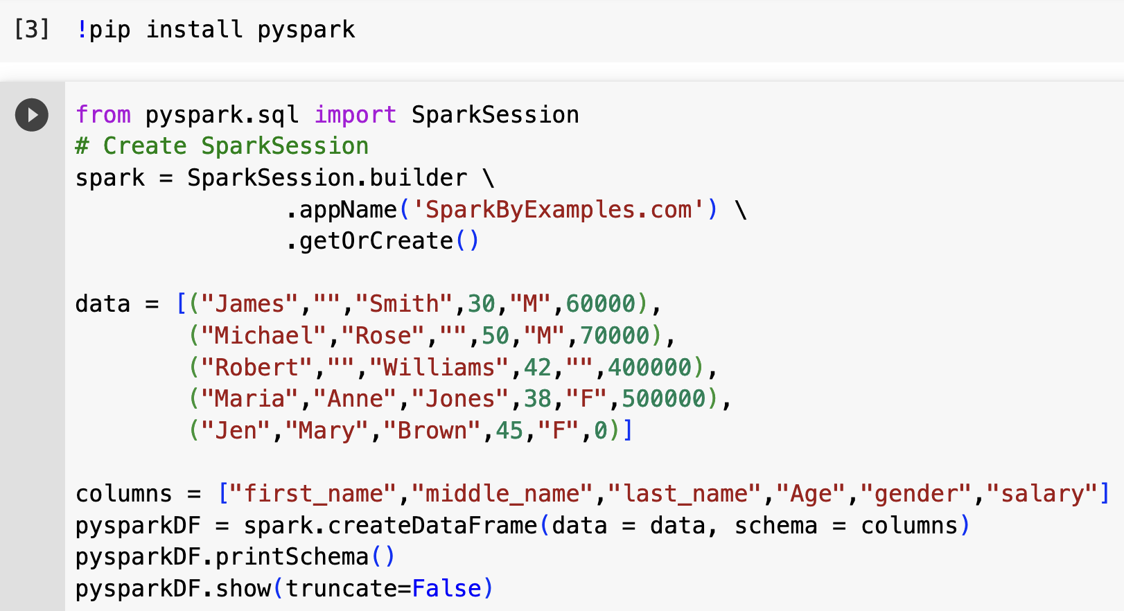
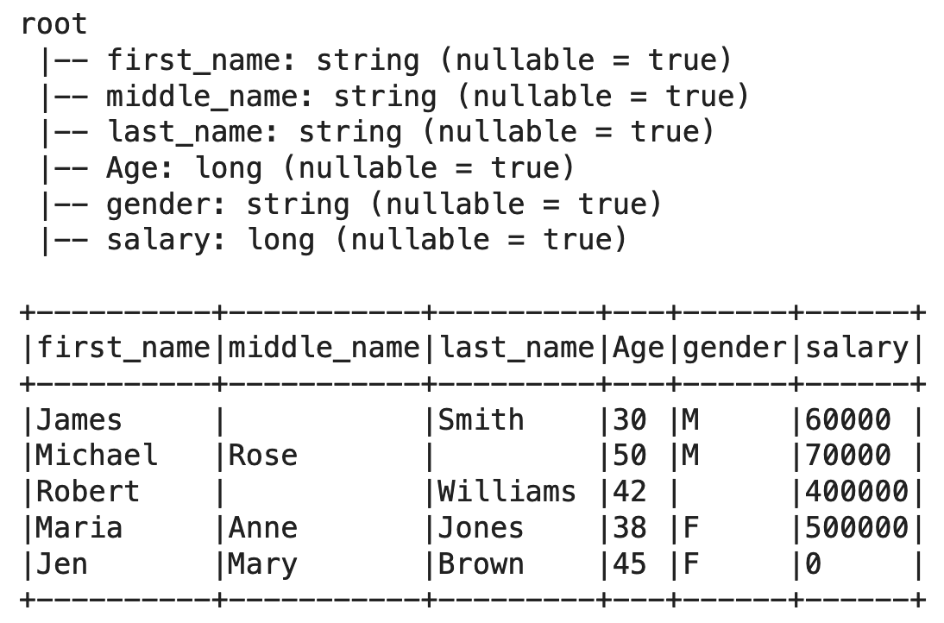
Pandas vs PySpark DataFrame
AI VIETNAM
All-in-One Course
In very simple words Pandas run operations on a single machine whereas PySpark runs on multiple machines. If you are working on a Machine Learning application where you are dealing with larger datasets, PySpark is a best fit which could processes operations many times(100x) faster than Pandas.
Notes:
https://sparkbyexamples.com/pyspark/pandas-vs-pyspark-dataframe-with-examples/?expand_article=1

Slide 17
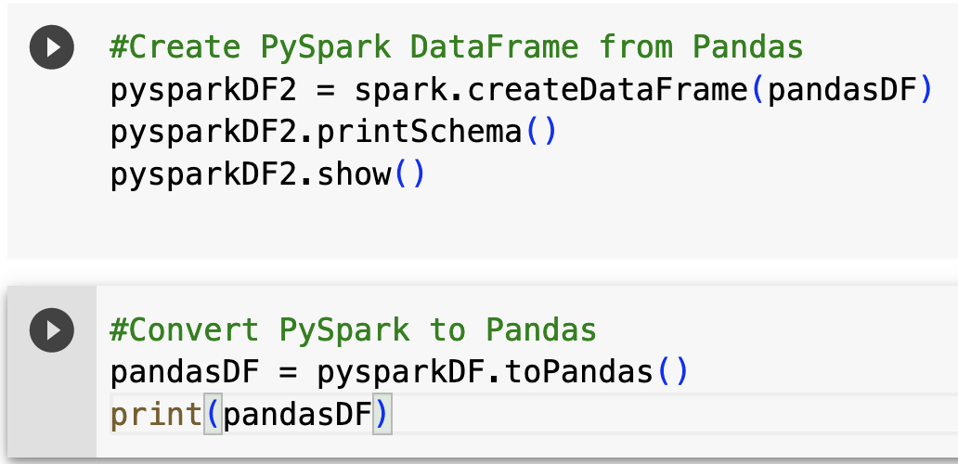
AI VIETNAM
All-in-One Course
Pandas ⬄ PySpark DataFrame

Slide 18
AI VIETNAM
All-in-One Course
How to Decide Between Pandas vs PySpark
If your data is huge and grows significantly over the years and you wanted to improve your processing time.
If you want fault-tolerant.
ANSI SQL compatibility.
Language to choose (Spark supports Python, Scala, Java & R)
When you want Machine-learning capability.
Would like to read Parquet, Avro, Hive, Casandra, Snowflake e.t.c
If you wanted to stream the data and process it real-time.

Slide 19
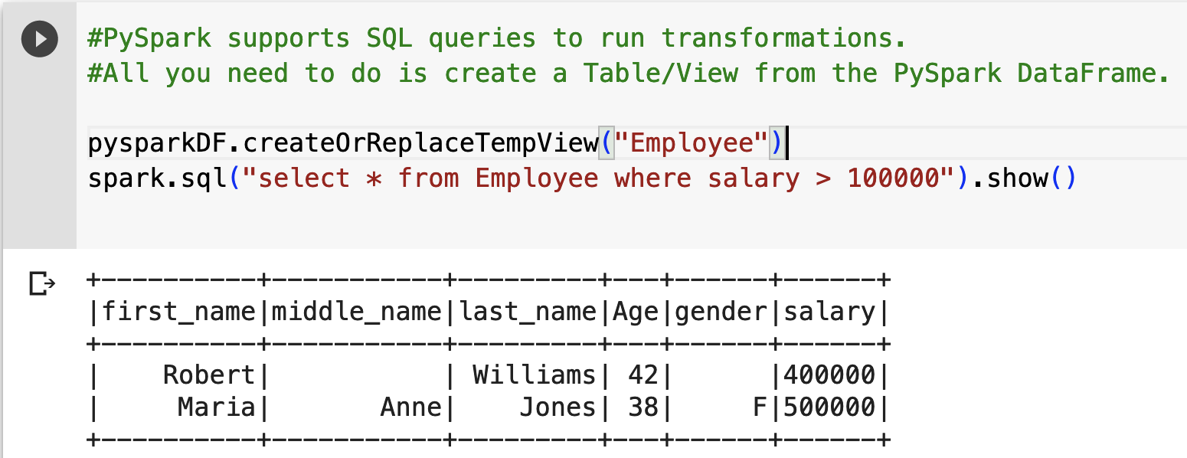
PySpark SQL Compatible
AI VIETNAM
All-in-One Course
Notes:
https://sparkbyexamples.com/pyspark/pandas-vs-pyspark-dataframe-with-examples/?expand_article=1

Slide 20
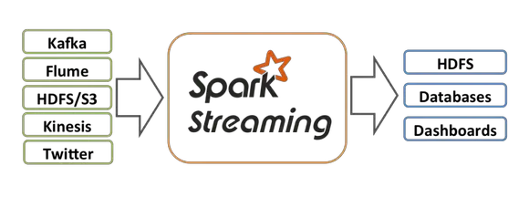
PySpark Streaming
AI VIETNAM
All-in-One Course
PySpark Streaming is a scalable, high-throughput, fault-tolerant streaming processing system that supports both batch and streaming workloads. It is used to process real-time data from sources like file system folder, TCP socket, S3, Kafka, Flume, Twitter, and Amazon Kinesis to name a few. The processed data can be pushed to databases, Kafka, live dashboards e.t.c
Notes:
https://sparkbyexamples.com/pyspark/pandas-vs-pyspark-dataframe-with-examples/?expand_article=1

Slide 21
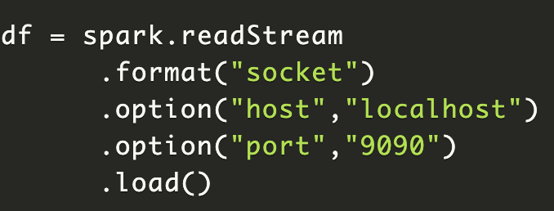
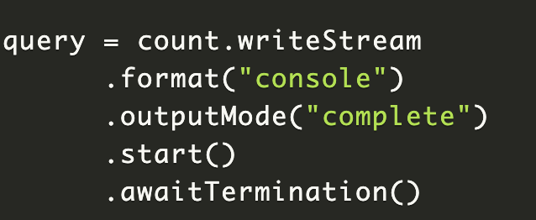
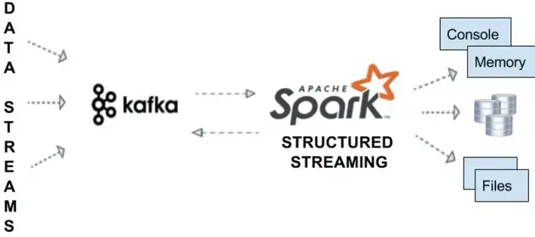
Streaming from TCP Socket
AI VIETNAM
All-in-One Course
Streaming from Kafka
Notes:
https://sparkbyexamples.com/pyspark/pandas-vs-pyspark-dataframe-with-examples/?expand_article=1
After processing, you can stream the DataFrame to console. In real-time, we ideally stream it to either Kafka, database e.t.c
https://sparkbyexamples.com/spark/spark-streaming-with-kafka/

Slide 22
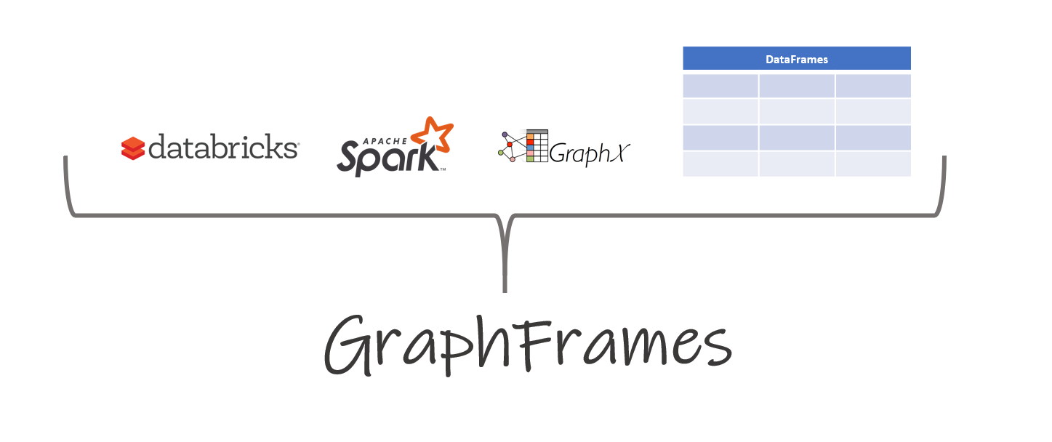
Graph Modeling in PySpark using GraphFrames
AI VIETNAM
All-in-One Course
Notes:
https://blog.devgenius.io/graph-modeling-in-pyspark-using-graphframes-part-1-e7cb42099182

Slide 23
Setting up GraphFrames
AI VIETNAM
All-in-One Course
Download “graphframes-0.8.2-spark3.0-s_2.12” https://spark-packages.org/package/graphframes/graphframes
extract the JAR contents from graphframes-0.8.2-spark3.0-s_2.12
Navigate to “graphframe” directory and zip the contents inside of it. zip graphframes.zip -r *
copy the zipped file “graphframes.zip” C:\spark-3.1.2-bin-hadoop3.2\python
Copy the graphframes-0.8.2-spark3.0-s_2.12.jar file into C:\spark-3.1.2-bin-hadoop3.2\jars

Slide 24
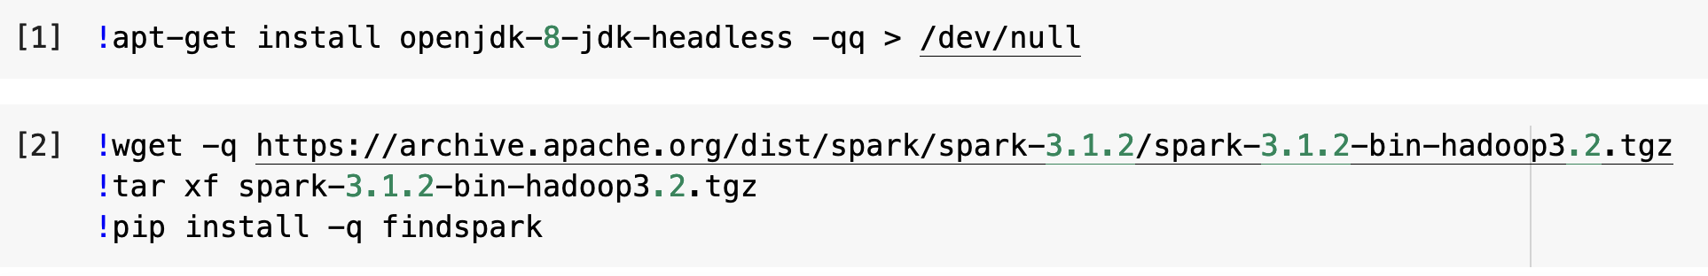
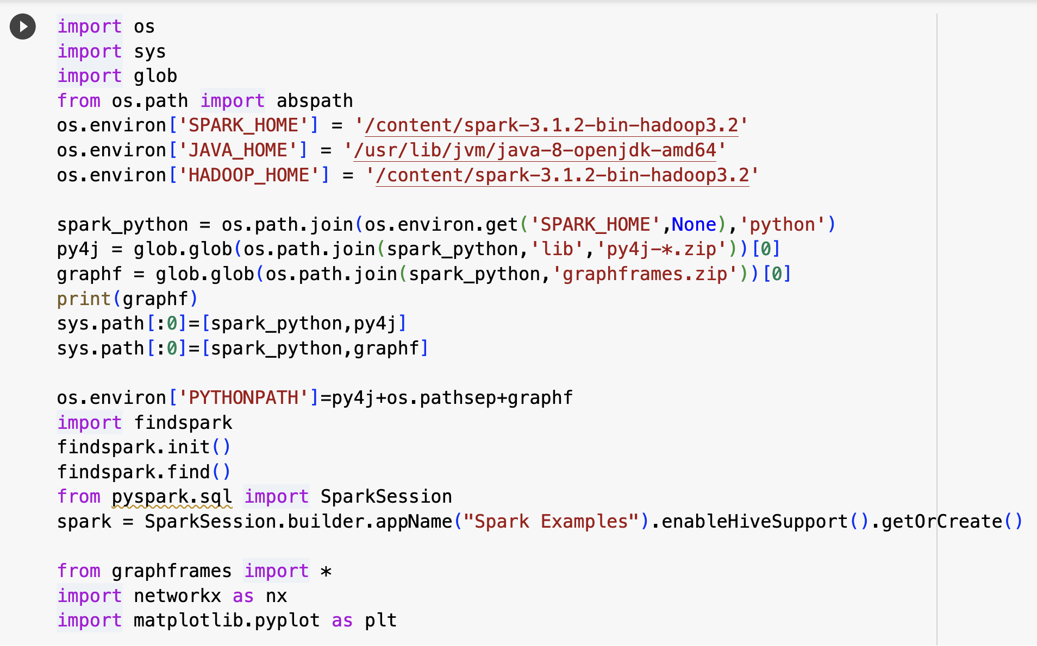
Graph Modeling in PySpark using GraphFrames
AI VIETNAM
All-in-One Course

Slide 25
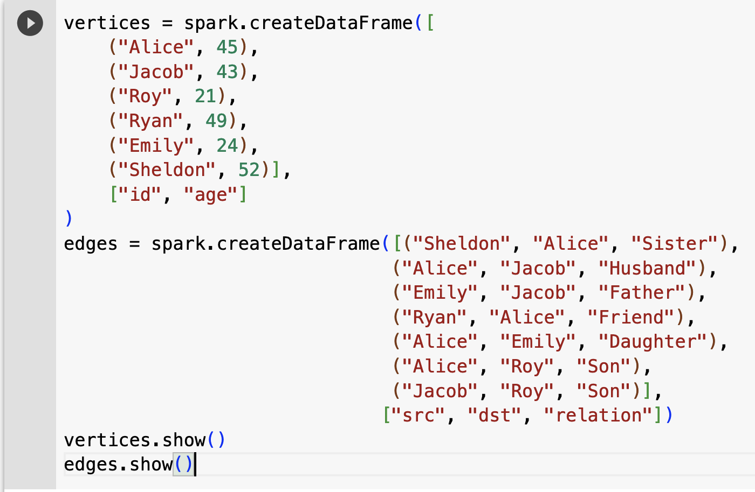
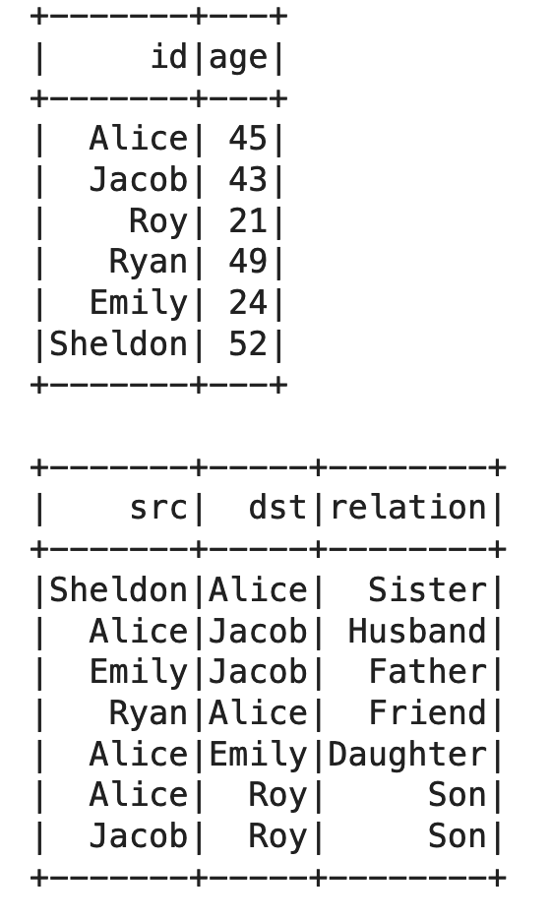
AI VIETNAM
All-in-One Course
Graph Modeling in PySpark using GraphFrames

Slide 26
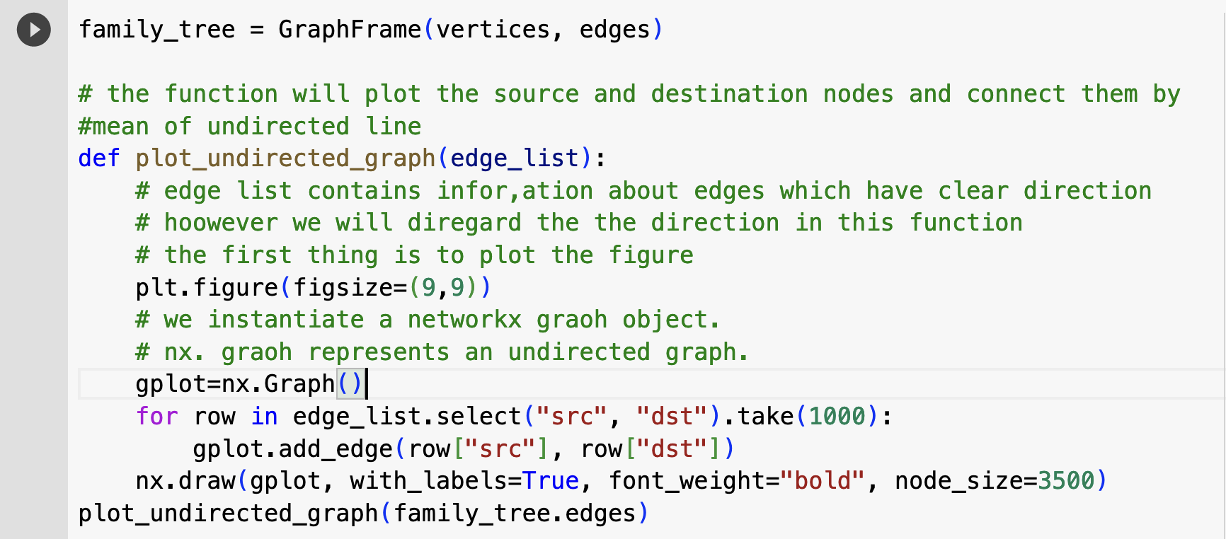
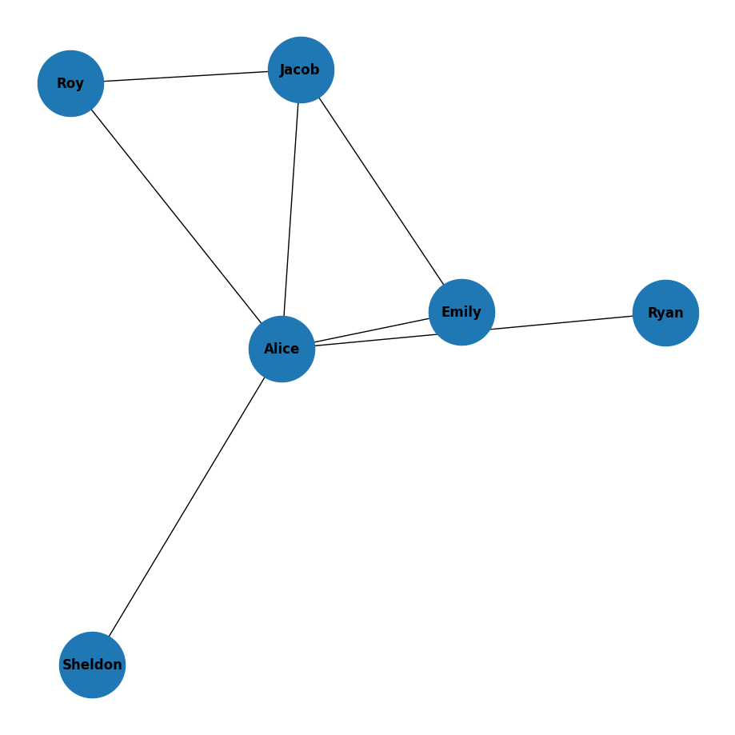
AI VIETNAM
All-in-One Course
Graph Modeling in PySpark using GraphFrames

Slide 27
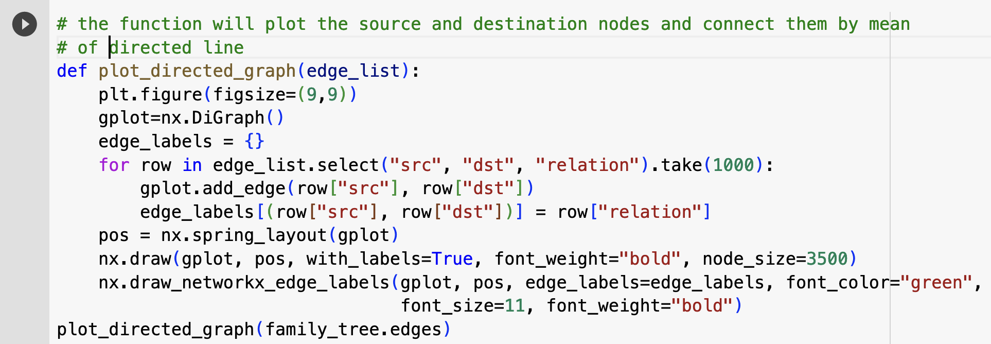
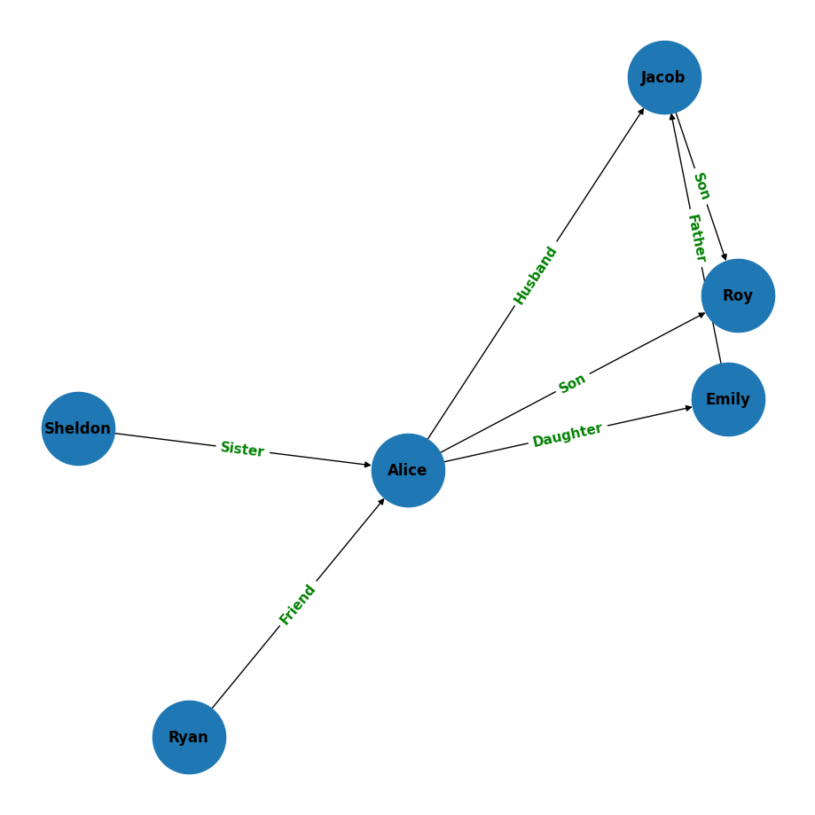
Graph Modeling in PySpark using GraphFrames
AI VIETNAM
All-in-One Course

Slide 28

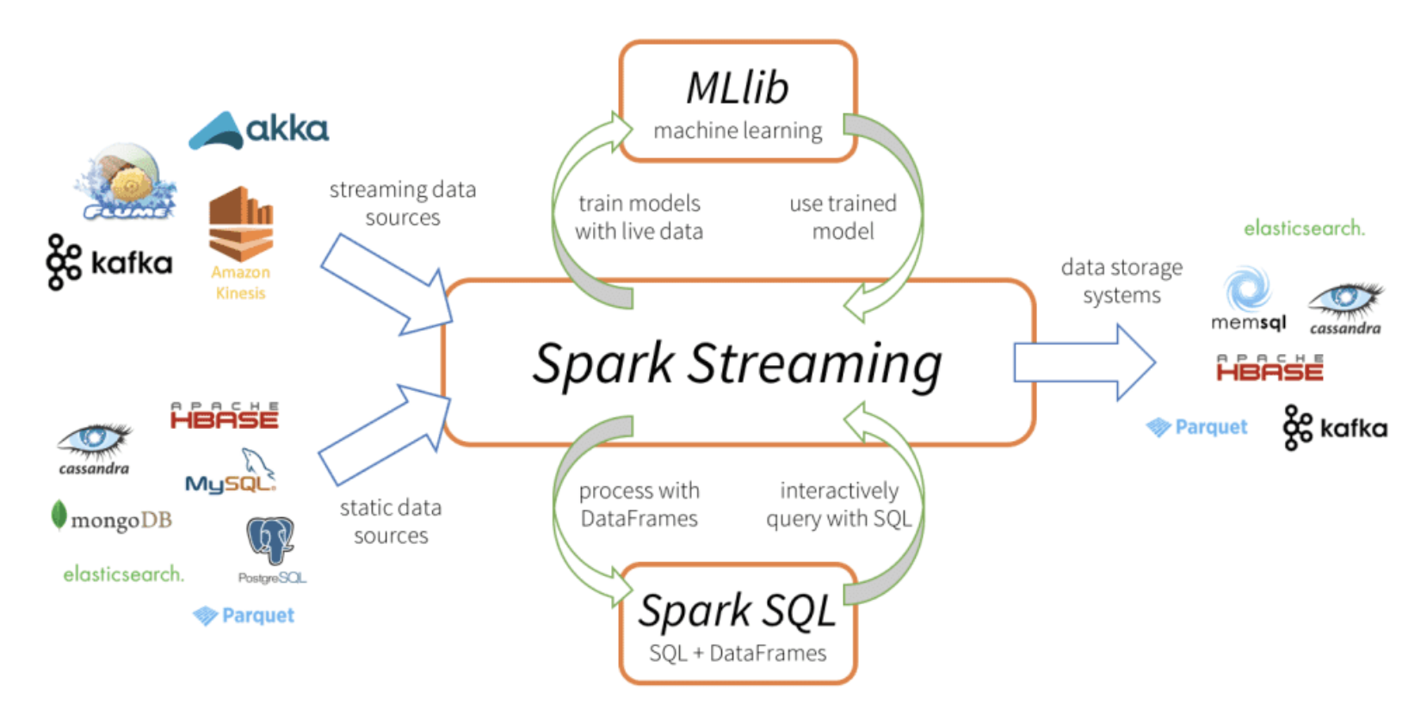
PySpark MLlib
AI VIETNAM
All-in-One Course
Notes:
https://sparkbyexamples.com/pyspark/pandas-vs-pyspark-dataframe-with-examples/?expand_article=1
After processing, you can stream the DataFrame to console. In real-time, we ideally stream it to either Kafka, database e.t.c
https://www.analyticsvidhya.com/blog/2022/05/an-end-to-end-guide-on-building-a-regression-pipeline-using-pyspark/

Slide 29
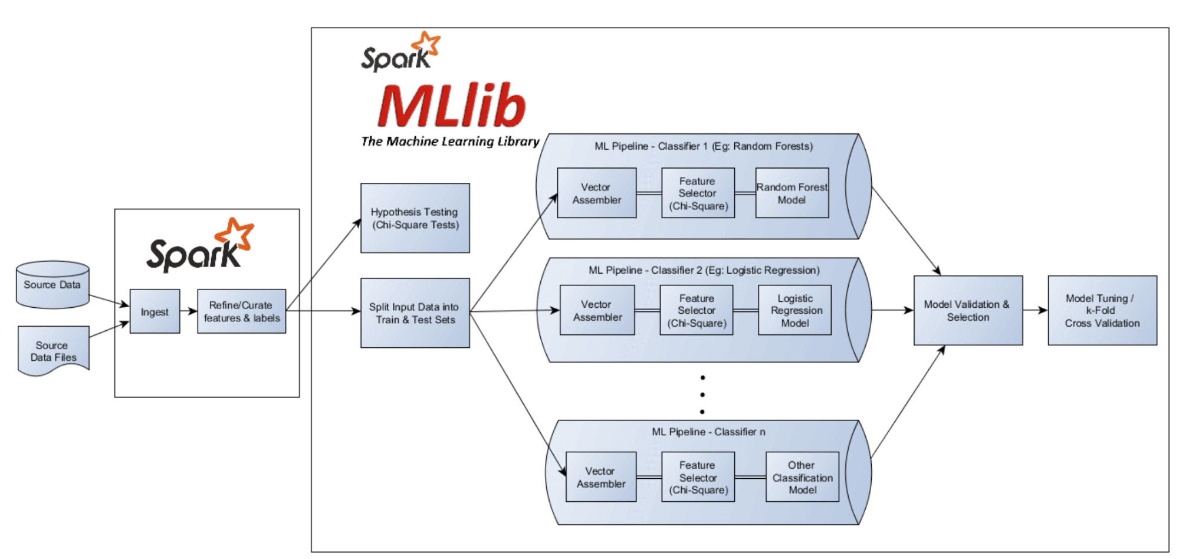
Linear Regression With PySpark
AI VIETNAM
All-in-One Course
https://www.qubole.com/wp-content/uploads/2018/12/image15.png

Slide 30
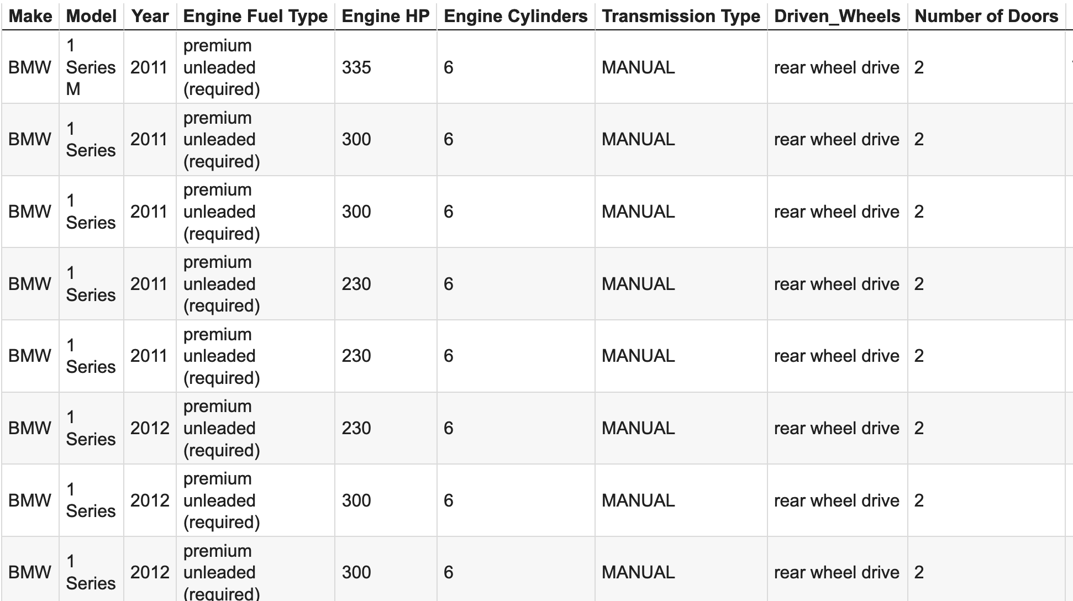
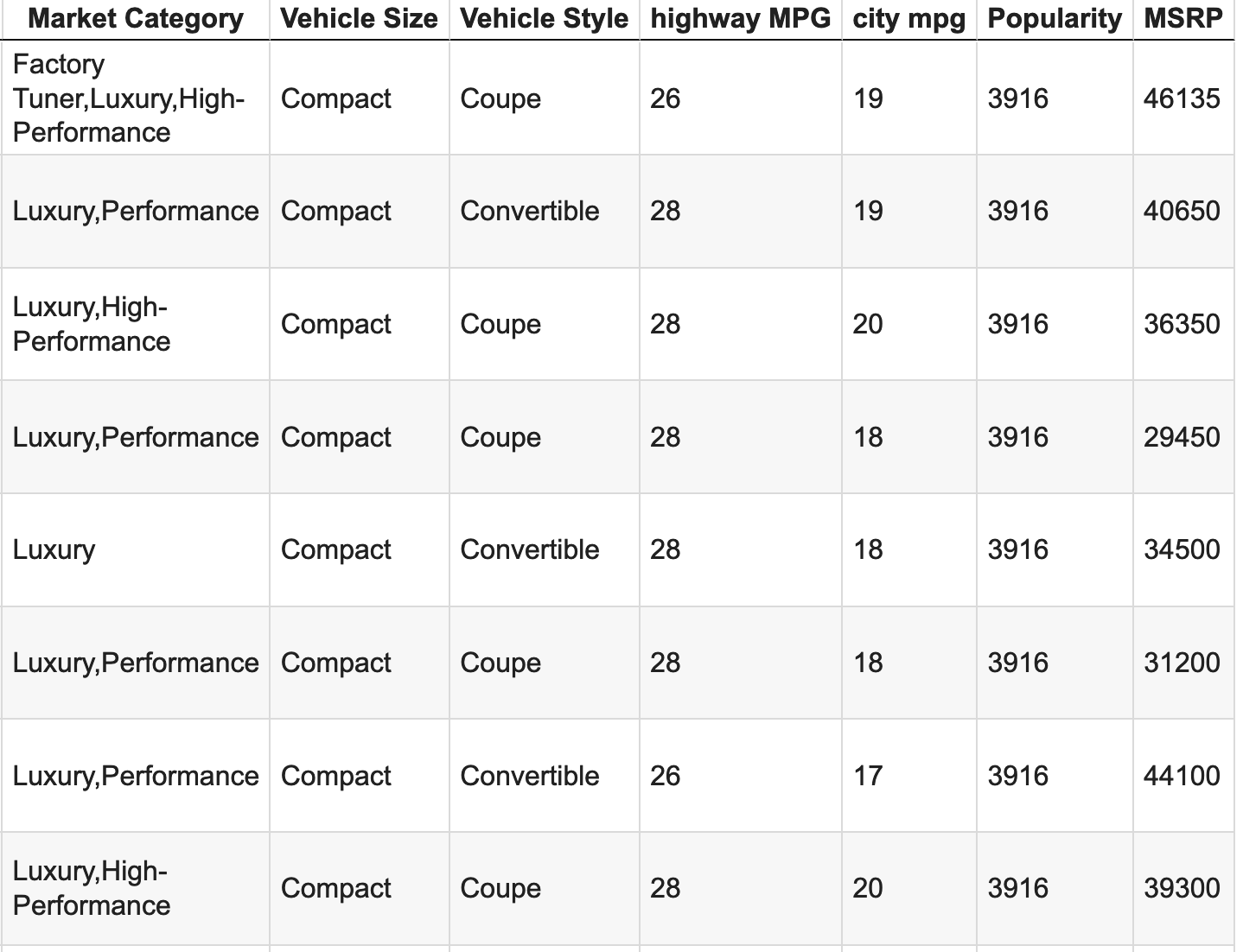
Regression With PySpark
AI VIETNAM
All-in-One Course
Predict Manufacturer’s Suggested Retail Price (MSRP)
Dataset: https://www.kaggle.com/datasets/hashroot97/carpriceprediction
Car Price Prediction Dataset

Slide 31
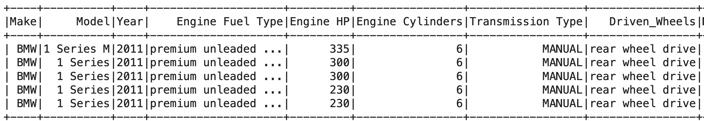
Regression With PySpark
AI VIETNAM
All-in-One Course
# Cài đặt pyspark
!pip install pyspark
!pip install findspark
import findspark
findspark.init()
# Cấu hình các thư viện cần thiết
import pandas as pd
import matplotlib.pyplot as plt
from pyspark.sql import SparkSession
from pyspark import SparkContext, SparkConf
# local[*] → Create a session using all CPU cores available.
# getOrCreate → A new session is created if a context is not already been created.
sc = SparkSession.builder.master("local[*]").getOrCreate()
data = sc.read.csv('/content/car_data.csv', inferSchema = True, header = True)
data.show(5)

Slide 32
Regression With PySpark
AI VIETNAM
All-in-One Course
# Cài đặt pyspark
!pip install pyspark
!pip install findspark
import findspark
findspark.init()
# Cấu hình các thư viện cần thiết
import pandas as pd
import matplotlib.pyplot as plt
from pyspark.sql import SparkSession
from pyspark import SparkContext, SparkConf
# local[*] → Create a session using all CPU cores available.
# getOrCreate → A new session is created if a context is not already been created.
sc = SparkSession.builder.master("local[*]").getOrCreate()
data = sc.read.csv('/content/car_data.csv', inferSchema = True, header = True)
data.show(5)

Slide 33
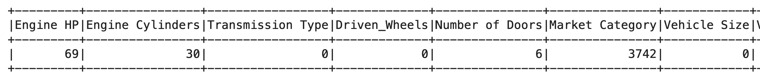
Regression With PySpark
AI VIETNAM
All-in-One Course
from pyspark.sql.functions import when,lit,count,isnan,col
def replace(column, value):
return when(column!=value,column).otherwise(lit(None))
data = data.withColumn("Market Category", replace(col("Market Category"),"N/A"))
data.select([count(when(isnan(c)|col(c).isNull(),c)).alias(c) for c in data.columns]).show()
#deleting the column Market Category
data = data.drop("Market Category")
# deleting the all null values
data = data.na.drop()
print((data.count(), len(data.columns)))
Market Category is not significant in our dataset hence we are free to drop this column.

Slide 34
Regression With PySpark
AI VIETNAM
All-in-One Course
# VectorAssembler from the Spark ML-lib class
from pyspark.ml.feature import VectorAssembler
assembler = VectorAssembler(inputCols = ["Year","Engine HP","Engine Cylinders","Number of Doors","Popularity",
"highway MPG","city mpg"],
outputCol = "Input Attributes")
# VectorAssembler from the Spark ML-lib class
from pyspark.ml.feature import VectorAssembler
assembler = VectorAssembler(inputCols = ["Year","Engine HP","Engine Cylinders","Number of Doors","Popularity",
"highway MPG","city mpg"],
outputCol = "features")
data = assembler.transform(data)
final_data = data.select("features", "MSRP")
train_data, test_data = final_data.randomSplit([0.8, 0.2], seed=42)
Notes:
https://www.machinelearningplus.com/pyspark/pyspark-linear-regression/

Slide 35
Regression With PySpark
AI VIETNAM
All-in-One Course
from pyspark.ml.regression import LinearRegression
from pyspark.ml.evaluation import RegressionEvaluator
#Build the linear regression model
lr = LinearRegression(featuresCol="features", labelCol="MSRP", predictionCol="predicted_MSRP")
lr_model = lr.fit(train_data)
#Make predictions and evaluate the model
predictions = lr_model.transform(test_data)
evaluator = RegressionEvaluator(labelCol="MSRP", predictionCol="predicted_MSRP", metricName="rmse")
rmse = evaluator.evaluate(predictions)
print("Root Mean Squared Error (RMSE) on test data: {:.3f}".format(rmse))
evaluator_r2 = RegressionEvaluator(labelCol="predicted_MSRP", predictionCol="predicted_MSRP", metricName="r2")
r2 = evaluator_r2.evaluate(predictions)
print("R-squared (R2) on test data: {:.3f}".format(r2))
Notes:
https://www.machinelearningplus.com/pyspark/pyspark-linear-regression/

Slide 36
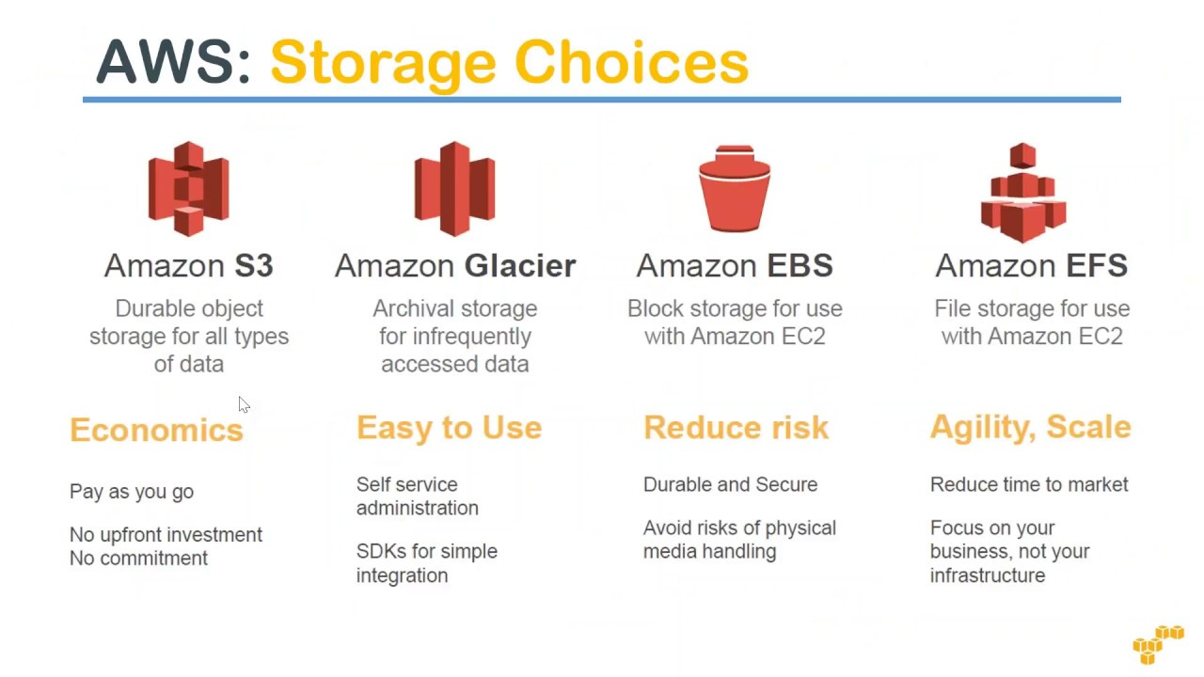

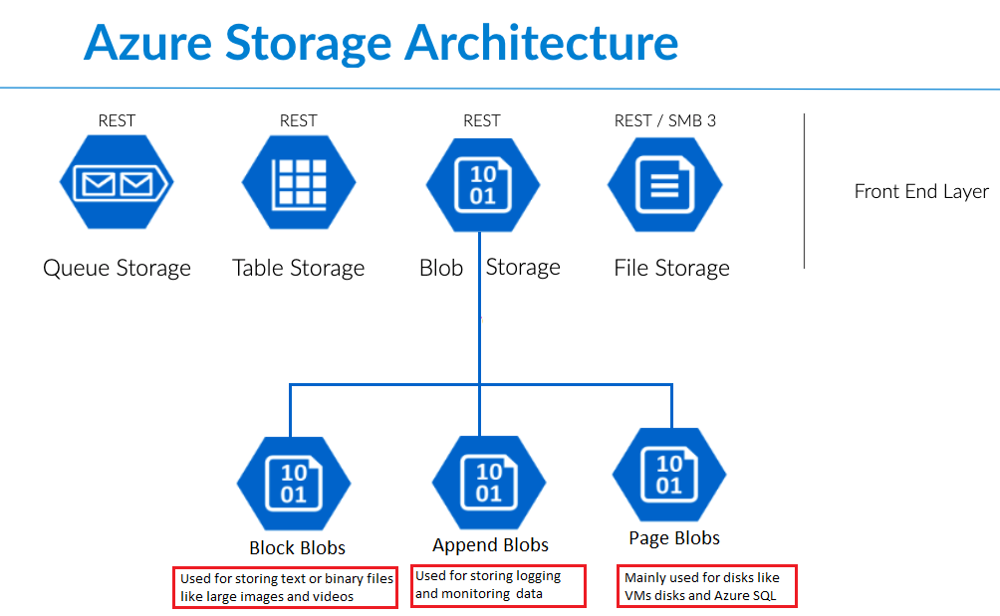
PySpark and Cloud
AI VIETNAM
All-in-One Course
Now that we have an understanding of how we’re going to process the data with Spark, the next question is where we’re going to store the big data
Working with of large datasets stored locally will eat up your disk space quickly, and options like GitHub or Google Drive don’t fit the bill for files large than a few hundred MB’s.
Amazon S3, Azure Blob Storage, Google Cloud Storage
Notes:
https://kontext.tech/article/689/pyspark-read-file-in-google-cloud-storage

Slide 37
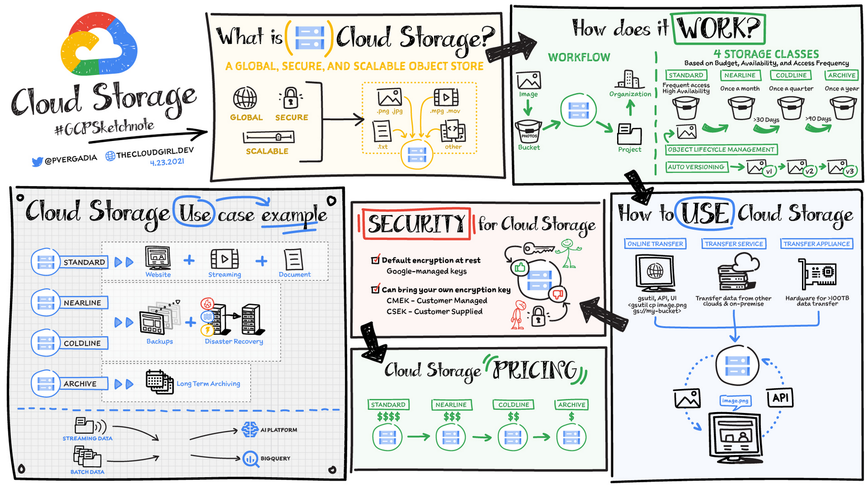
https://cloud.google.com/blog/topics/developers-practitioners/all-you-need-know-about-cloud-storage

Slide 38
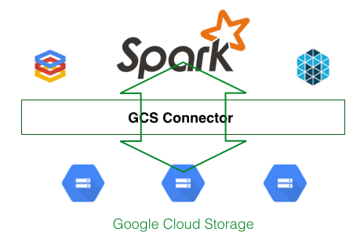

PySpark and Cloud
AI VIETNAM
All-in-One Course

Slide 39
HOW TO SETUP GOOGLE CLOUD STORAGE
AI VIETNAM
All-in-One Course

Slide 40
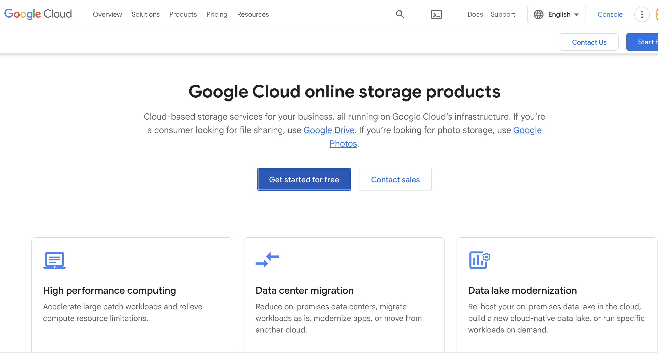
Navigate to the Google Cloud signup page
https://cloud.google.com/

Slide 41
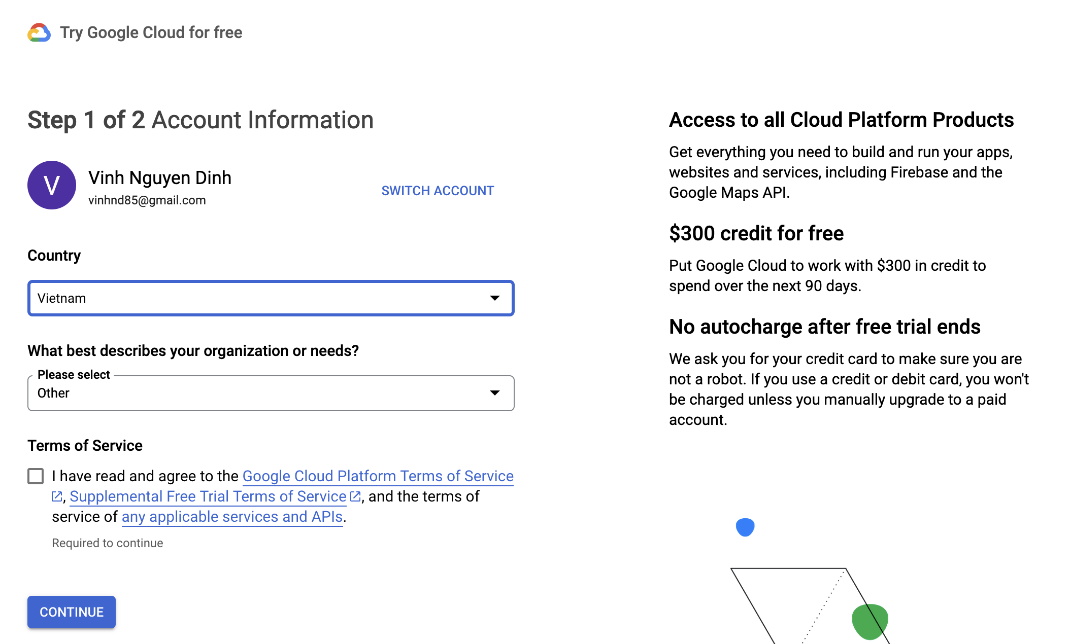
Make a GCP account using your Google account
AI VIETNAM
All-in-One Course

Slide 42
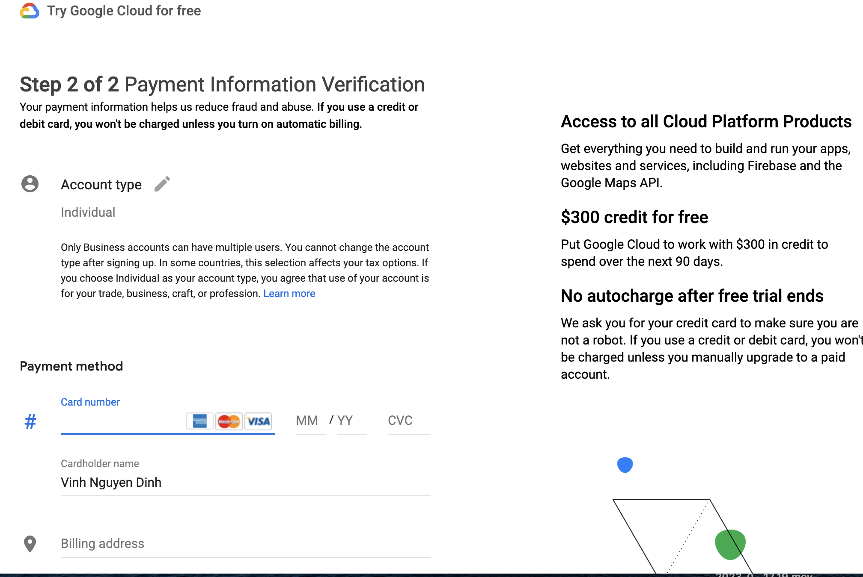
Make a GCP account using your Google account
AI VIETNAM
All-in-One Course

Slide 43
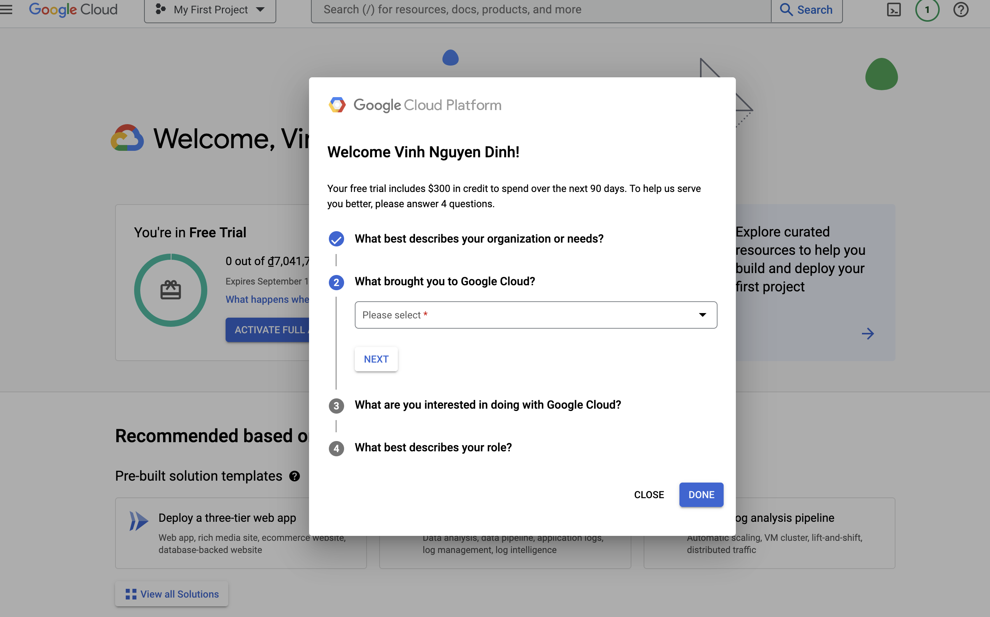
Make a GCP account using your Google account
AI VIETNAM
All-in-One Course

Slide 44
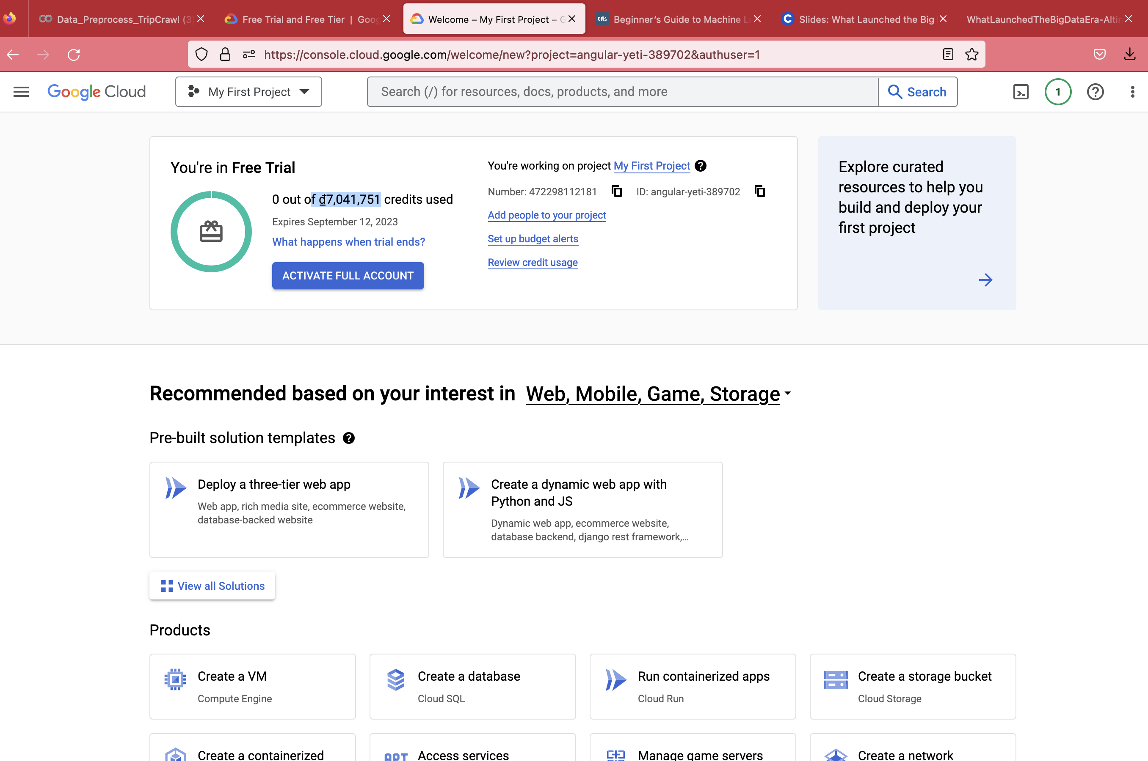
Make a GCP account using your Google account
AI VIETNAM
All-in-One Course

Slide 45
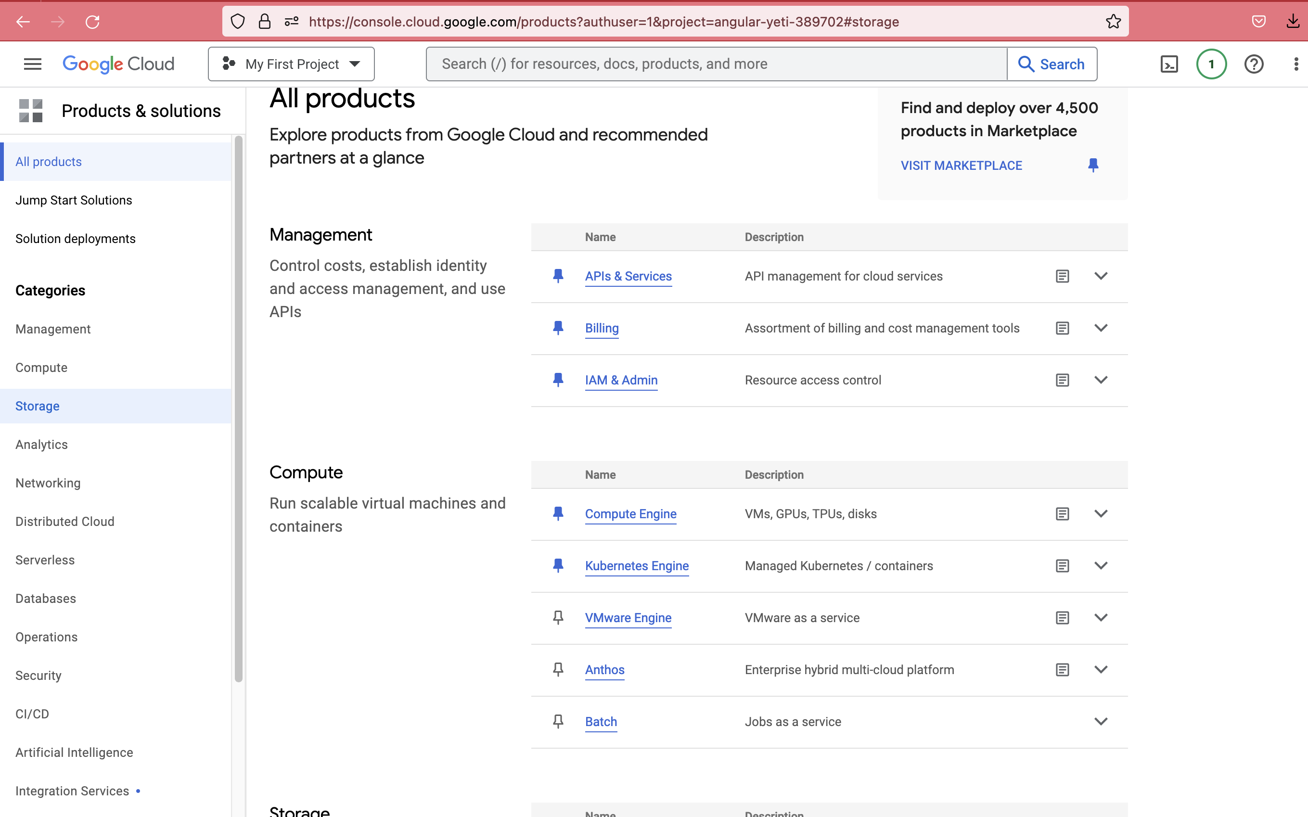
Once you have a GCP account created, navigate to the Google Cloud Console
AI VIETNAM
All-in-One Course

Slide 46
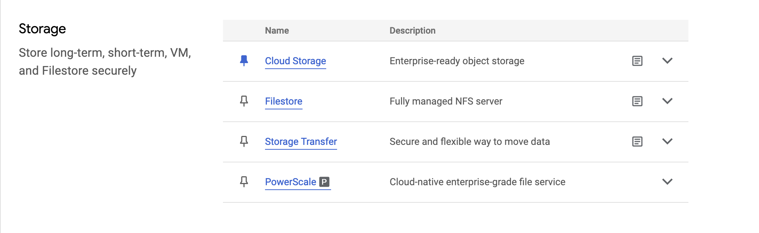
From the Google Cloud homepage, go to the Cloud Storage option in the left-hand sidebar
AI VIETNAM
All-in-One Course

Slide 47
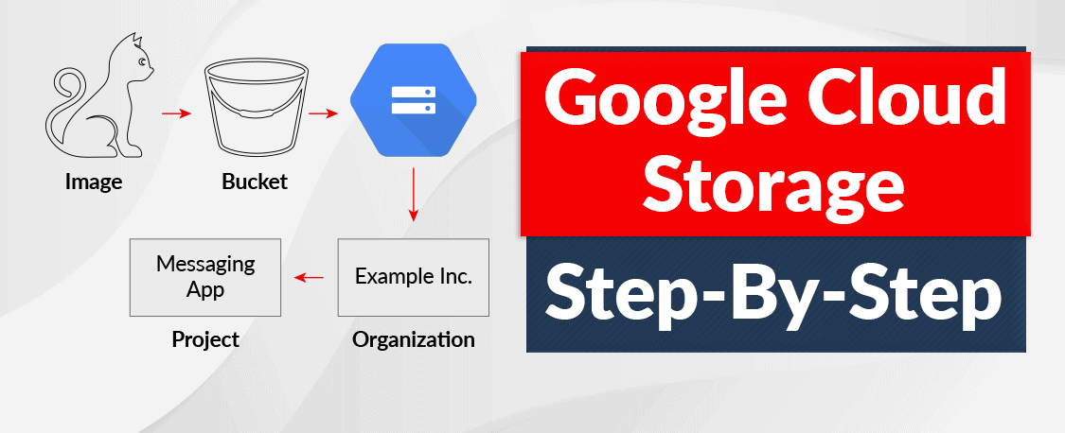
Google Cloud Storage
AI VIETNAM
All-in-One Course

Slide 48
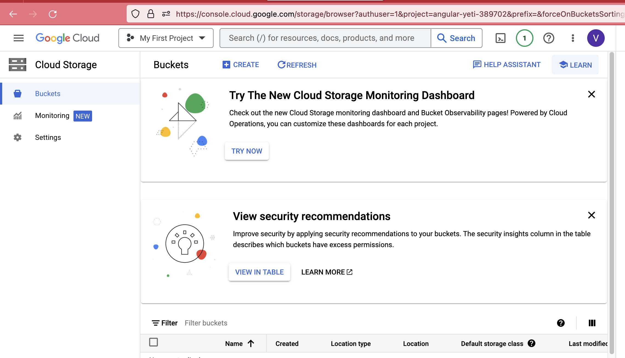
On the Google Cloud Storage, click ‘Create a Bucket’
AI VIETNAM
All-in-One Course

Slide 49

On the Google Cloud Storage, click ‘Create a Bucket’
AI VIETNAM
All-in-One Course

Slide 50

On the Google Cloud Storage, click ‘Create a Bucket’
AI VIETNAM
All-in-One Course

Slide 51

On the Google Cloud Storage, click ‘Create a Bucket’
AI VIETNAM
All-in-One Course

Slide 52

On the Google Cloud Storage, click ‘Create a Bucket’
AI VIETNAM
All-in-One Course

Slide 53

On the Google Cloud Storage, click ‘Create a Bucket’
AI VIETNAM
All-in-One Course

Slide 54

On the Google Cloud Storage, click ‘Create a Bucket’
AI VIETNAM
All-in-One Course

Slide 55

Create a Service Account, and name it
AI VIETNAM
All-in-One Course

Slide 56

Create a Service Account, and name it
AI VIETNAM
All-in-One Course

Slide 57

Create a Service Account, and name it
AI VIETNAM
All-in-One Course
we want to grant this service account access to our Storage objects, so use the dropdown menu to give it that level of permissions. Find the Cloud Storage option, then Storage Object Admin

Slide 58

Create a Service Account, and name it
AI VIETNAM
All-in-One Course
we want to grant this service account access to our Storage objects, so use the dropdown menu to give it that level of permissions. Find the Cloud Storage option, then Storage Object Admin
Có thể chọn Storage Admin

Slide 59

Finish up the Service Account creation process
AI VIETNAM
All-in-One Course

Slide 60

Click on the account ID to access the details, then click on the ‘Keys’ tab along the top
AI VIETNAM
All-in-One Course

Slide 61

Click on the account ID to access the details, then click on the ‘Keys’ tab along the top
AI VIETNAM
All-in-One Course

Slide 62


‘Add Key’ => ‘Create New Key’ => JSON
AI VIETNAM
All-in-One Course
KEEP THIS SECURE
This should automatically download the key to your local machine

Slide 63

‘Add Key’ => ‘Create New Key’ => JSON
AI VIETNAM
All-in-One Course
KEEP THIS SECURE
This should automatically download the key to your local machine

Slide 64

‘Add Key’ => ‘Create New Key’ => JSON
AI VIETNAM
All-in-One Course

Slide 65

Loading the Data to The Bucket
AI VIETNAM
All-in-One Course

Slide 66

Loading the Data to The Bucket
AI VIETNAM
All-in-One Course

Slide 67

Loading the Data to The Bucket
AI VIETNAM
All-in-One Course

Slide 68

Loading the Data to The Bucket
AI VIETNAM
All-in-One Course

Slide 69

Another Solution: Create a Bucket from Code
AI VIETNAM
All-in-One Course

Slide 70

Another Solution: Create a Bucket from Code
AI VIETNAM
All-in-One Course

Slide 71

Download Files From a Bucket
AI VIETNAM
All-in-One Course

Slide 72


Upload Files to a Bucket
AI VIETNAM
All-in-One Course

Slide 73


Access Bucket Information
AI VIETNAM
All-in-One Course

Slide 74

AI VIETNAM
All-in-One Course
HOW TO SETUP PYSPARK

Slide 75


AI VIETNAM
All-in-One Course
How to Install PySpark

Slide 76

AI VIETNAM
All-in-One Course
How to Install PySpark
https://cloud.google.com/dataproc/docs/concepts/connectors/cloud-storage

Slide 77

AI VIETNAM
All-in-One Course
Access to GCS to get a File using PySpark
PySpark allows you to manipulate large datasets using a powerful and efficient API. The most important class for data manipulation in PySpark is the DataFrame. A DataFrame is a distributed collection of data organized into named columns. It is similar to a table in a relational database, and it can be manipulated using SQL queries.

Slide 78
AI VIETNAM
All-in-One Course
Access to GCS to get a File using PySpark
PySpark DataFrame is mostly similar to Pandas DataFrame with the exception PySpark DataFrames are distributed in the cluster (meaning the data in DataFrame’s are stored in different machines in a cluster) and any operations in PySpark executes in parallel on all machines whereas Panda Dataframe stores and operates on a single machine

Slide 79

AI VIETNAM
All-in-One Course
Access to GCS to get a File using PySpark
GCSFS: A pythonic file-system interface to Google Cloud Storage

Slide 80

AI VIETNAM
All-in-One Course
PySpark + SQL
# Data frame: read CSV file into table
df = spark.read.option("header",True).csv("/content/zipcodes.csv")
df.printSchema()
df.show()

Slide 81
AI VIETNAM
All-in-One Course
PySpark + SQL
# Spark: Read CSV file
bucket_name="aivnbigdata"
path=f"gs://{bucket_name}/asteroid/zipcodes.csv" spark.read.option("header",True).csv(path).createOrReplaceTempView("Zipcodes")

Slide 82


AI VIETNAM
All-in-One Course
PySpark + SQL
Data Frame
Spark

Slide 83


AI VIETNAM
All-in-One Course
PySpark + SQL
Data Frame
Spark

Slide 84


AI VIETNAM
All-in-One Course
PySpark + SQL
Data Frame
Spark

Slide 85


AI VIETNAM
All-in-One Course
PySpark + SQL
Data Frame
Spark
Notes:
https://sparkbyexamples.com/pyspark/pyspark-sql-with-examples/

Slide 86


AI VIETNAM
All-in-One Course
Building an ML application PySpark and GCS with Cluster
Notes:
Building an ML application using MLlib in Pyspark
https://towardsdatascience.com/building-an-ml-application-with-mllib-in-pyspark-part-1-ac13f01606e2

Slide 87
How to Work with Spark
AI VIETNAM
All-in-One Course
Deploy Cluster
After Setting Cluster
Spark shell
Spart submit
Notebook
SparkSession
Example

Slide 88


How to create a cluster
AI VIETNAM
All-in-One Course

Slide 89

How to create a cluster
AI VIETNAM
All-in-One Course

Slide 90

How to create a cluster
AI VIETNAM
All-in-One Course

Slide 91

How to create a cluster
AI VIETNAM
All-in-One Course

Slide 92


How to create a cluster
AI VIETNAM
All-in-One Course

Slide 93

How to create a cluster
AI VIETNAM
All-in-One Course

Slide 94

How to create a cluster
AI VIETNAM
All-in-One Course

Slide 95

How to create a cluster
AI VIETNAM
All-in-One Course

Slide 96

How to create a cluster
AI VIETNAM
All-in-One Course

Slide 97

How to create a cluster
AI VIETNAM
All-in-One Course

Slide 98

How to create a cluster
AI VIETNAM
All-in-One Course

Slide 99

How to create a cluster
AI VIETNAM
All-in-One Course

Slide 100

How to create a cluster
AI VIETNAM
All-in-One Course

Slide 101


How to create a cluster
AI VIETNAM
All-in-One Course

Slide 102
How to create a cluster
AI VIETNAM
All-in-One Course

Slide 103


How to create a cluster
AI VIETNAM
All-in-One Course

Slide 104

How to create a cluster
AI VIETNAM
All-in-One Course

Slide 105


How to create a cluster
AI VIETNAM
All-in-One Course

Slide 106



Submit Job to Spark cluster
AI VIETNAM
All-in-One Course

Slide 107

SparkSession
AI VIETNAM
All-in-One Course

Slide 108

How to Run Spark Application?
AI VIETNAM
All-in-One Course
Running on shell: spark shell
df = spark.createDataFrame([(1,'Andy'),(2,'mandy'),(3,'sandy')])

Slide 109

How to Run Spark Application?
AI VIETNAM
All-in-One Course
Submit your spark application: spark-submit
We need to create for the application
df = spark.createDataFrame([(1,'Andy'),(2,'mandy'),(3,'sandy')])

Slide 110



AI VIETNAM
All-in-One Course
Creating and Loading the data into Pyspark Dataframe

Slide 111


Apache Spark Dataframe
AI VIETNAM
All-in-One Course

Slide 112

Submit a spark job in GCP dataproc
AI VIETNAM
All-in-One Course
gcloud dataproc jobs submit pyspark gs://dataproc-staging-us-central1-558853654924-mop7md33/notebooks/jupyter/example.py --cluster=spark-cluster --region=us-central1

Slide 113

Submit a spark job in GCP dataproc
AI VIETNAM
All-in-One Course

Slide 114

Submit a spark job in GCP dataproc
AI VIETNAM
All-in-One Course

Slide 115

Manage Job Information
AI VIETNAM
All-in-One Course

Slide 116

Manage Job Information
AI VIETNAM
All-in-One Course

Slide 117


